Slide 1

UE20CS390A – Capstone Project Phase – 1
Project Progress Review #3
Project Title : Image Tampering Detection
Project ID : PW23_SRU1
Project Guide : Dr. Sujatha R Upadhyaya
Project Team : Anil Kumar MG PES1UG21CS804
Divya M PES1UG21CS810
Nagaratna Manjunath Naik PES1UG21CS821
Nandana CL PES1UG21CS822

Slide 2
Image Tampering Detection
Outline
Abstract
Suggestions from Review - 2
Proposed Methodology
Design Constraints & Assumptions
Dependencies
HLD
Technologies Used
Pseudocode
Implementation
Project Progress
References

Slide 3
Image Tampering Detection
Abstract
Problem Statement:
With the increased availability of digital image editing tools, it has become increasingly easier to manipulate images which are too difficult for the human eye to detect. This has led to an increase in the number of tampered images that are spread online. These tampered images are being used various malicious purposes, including spreading fake news or even defaming someone. Traditional methods of detecting tampered images rely on visual inspection, which is time-consuming and prone to errors. So there is a need for an automated system that can accurately and efficiently detect image tampering.
Scope:
Input image : RGB
Tampering types : Copy-move, image splicing

Slide 4
Image Tampering Detection
Suggestions from Review - 2
Explore research direction where there is no requirement for original image in testing.

Slide 5
Image Tampering Detection
Proposed Methodology
Preprocessing: The input RGB image is converted to the YCbCr color space to separate the luminance (Y) and chrominance (Cb and Cr) components.
Feature Extraction using CNN: A convolutional neural network (CNN) is used to learn the features of authentic and tampered regions in the image. The CNN consists of multiple layers of filters that perform convolutions on the input image to extract different features at different scales.
Training with the CNN and SGD: The CNN is trained on a dataset of labeled images, including both authentic and tampered images. The training process involves feeding the labeled images into the CNN, which learns to extract features from the images and classify them as authentic or tampered. The training process is typically done using stochastic gradient descent (SGD) to adjust the weights and biases of the network to minimize the loss function and improve its accuracy in detecting tampered images..

Slide 6
Image Tampering Detection
Proposed Methodology
Tampered Region Localization with Sliding Window Detection: Once the CNN has been trained to recognize tampered images, it can be used to localize the tampered regions within an image. This is done using a technique called sliding window detection, where a small window is moved across the image at different positions and scales, and the CNN is used to classify each window as authentic or tampered. The regions with the highest probability of being tampered are then considered as the tampered regions.
Post-processing with NMS: To improve the accuracy of the tampered region localization, post-processing techniques can be applied, such as non-maximum suppression (NMS), which removes overlapping regions and keeps only the regions with the highest probability of being tampered.
Tampered Image Output: Finally, the system outputs whether the image is tampered or not and the tampered image with the localized tampered regions highlighted.

Slide 7
Image Tampering Detection
Image Tampering Detection
Benefits of the Proposed Approach
Accurate tampered region detection: The use of CNNs and sliding window detection helps to accurately detect tampered regions in an image, even in cases where the tampering is subtle or difficult to detect.
Flexibility: The use of multiple layers of filters in the CNN allows the network to learn and extract features at different scales, making it adaptable to different types of tampering.
Generalization: The use of a large and diverse dataset for training the CNN helps to ensure that the network can generalize well to new, unseen images.
Speed: The use of sliding window detection and post-processing techniques such as NMS helps to improve the speed of tampered region detection, making it feasible for real-time applications.

Slide 8
Image Tampering Detection
Image Tampering Detection
Drawbacks of the Proposed Approach
Complexity: The use of CNNs and sliding window detection requires a high degree of computational complexity, making it difficult to implement on low-end devices.
Training data requirements: The accuracy of the tampered region detection depends on the quality and size of the training dataset, which can be time-consuming and expensive to create.
Sensitivity to noise: The CNN may be sensitive to noise or other artifacts in the input image, which can lead to false positives or false negatives in tampered region detection.

Slide 9
Image Tampering Detection
Design Constraints
The CNN must be trained on a large dataset of labeled images, which requires significant computational resources and time.
The accuracy of the tampered region localization may be affected by the size and complexity of the image, as well as the quality and type of tampering.
The use of additional input channels (Cb and Cr) may increase the computational requirements and memory usage of the system.

Slide 10
Image Tampering Detection
Assumptions
The YCbCr color space provides a more effective representation of the image for tampering detection than the RGB color space.
The use of CNN is an effective approach for learning the features of authentic and tampered regions in an image.
The sliding window detection technique is an effective approach for localizing tampered regions within an image.
The post-processing techniques, such as non-maximum suppression, are effective in improving the accuracy of the tampered region localization.

Slide 11
Image Tampering Detection
Dependencies
Data availability: The design approach is highly dependent on the availability of a large and diverse dataset of tampered and untampered images. If the dataset is limited or biased, it can impact the accuracy and effectiveness of the tampered image detection system.
Quality of input images: The performance of the tampered image detection system is highly dependent on the quality of the input images. Poor image quality can affect the accuracy and effectiveness of the system.
Accuracy of YCbCr color space conversion: The design approach involves converting the input RGB image to YCbCr color space, and using the Y component as input to the CNN. The accuracy and reliability of this conversion process may impact the overall accuracy of the tampered region detection.

Slide 12
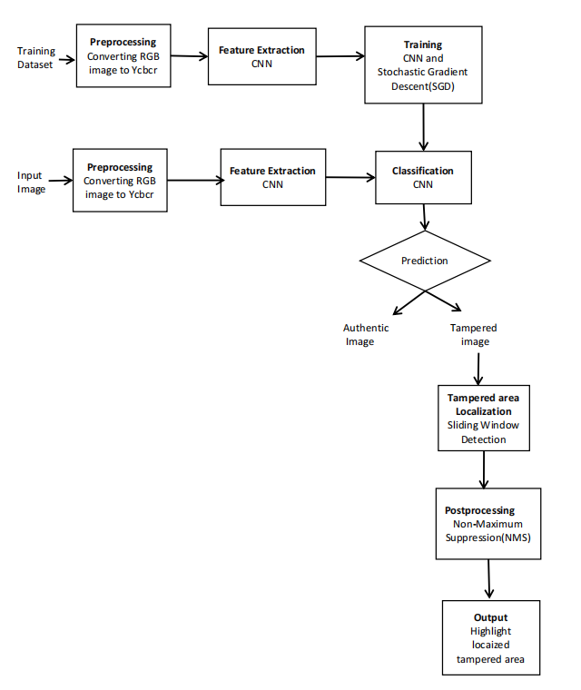
Image Tampering Detection
High-level design view of the system

Slide 13
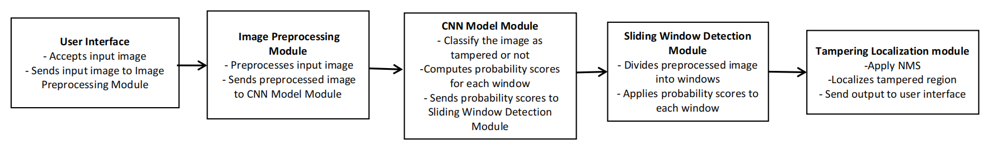
Image Tampering Detection
Collaboration and interaction between the major components

Slide 14
Image Tampering Detection
Technologies Used
OpenCV library: OpenCV is a widely used open-source computer vision library that provides a range of functions for image and video processing, feature detection, and object recognition. It can be used for tasks such as image preprocessing, color space conversion, and tampered region localization.
Convolutional Neural Network (CNN) frameworks: Deep learning frameworks such as TensorFlow, PyTorch, and Keras provide pre-built neural network architectures and tools for building and training CNNs for image classification and detection tasks.
Stochastic Gradient Descent (SGD): SGD is a popular optimization algorithm for training neural networks. It updates the weights and biases of the network based on the gradients of the loss function with respect to the parameters. It is computationally efficient and can handle large datasets, making it suitable for training the CNN on the labeled dataset.
Non-maximum Suppression (NMS): NMS is a post-processing technique that can be used to reduce the number of overlapping bounding boxes or regions. It keeps only the regions with the highest probability of being tampered, which improves the accuracy of the tampered region localization.

Slide 15
Image Tampering Detection
Pseudocode
// Preprocessing
input_image = preprocess(input_image) // convert RGB to Ycbcr, resize, normalize, remove noise
// Feature extraction
features = extract_features(input_image) // texture analysis, color analysis, edge detection
// Training model
model = train_model(features, labels)
// Tampering detection
probability = model.predict(input_image) // output probability score
if probability > threshold:
// Tampering localization
tampered_areas = localize_tampering(input_image) // sliding window, NMS
tampering_percentage = calculate_tampering_percentage(tampered_areas)
print("Image is tampered with tampering percentage: ", tampering_percentage)
else:
print("Image is not tampered")
Anil_Divya_Nagaratna_Nandana

Slide 16
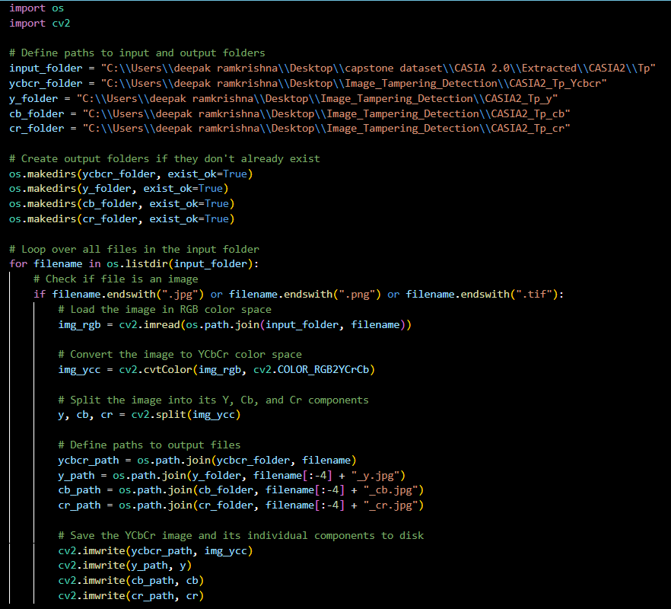
Image Tampering Detection
Implementation
Demonstrate the Implemented work if available.

Slide 17
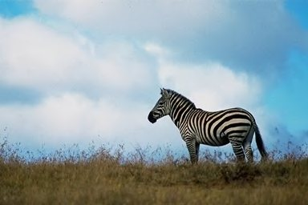

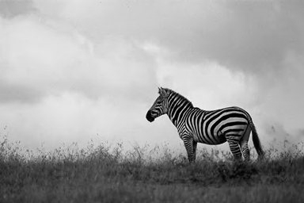
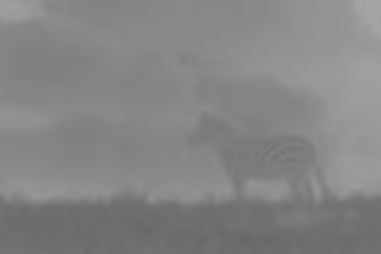
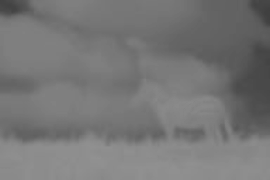
Image Tampering Detection
Original Image
RGB Image
Ycbcr Image
Y component
Cb component
Cr component
Anil_Divya_Nagaratna_Nandana

Slide 18
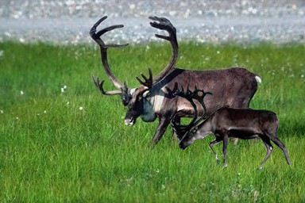
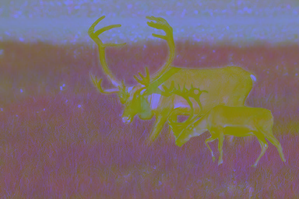
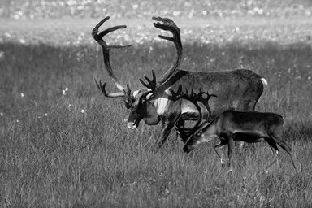
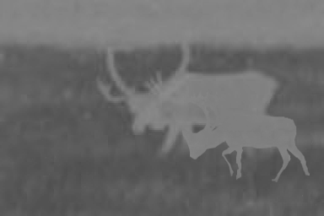
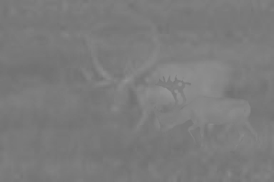
Image Tampering Detection
Tampered image
RGB Image
Ycbcr Image
Y component
Cb component
Cr component
Anil_Divya_Nagaratna_Nandana

Slide 19

Image Tampering Detection
Project Progress
What is the project progress so far?
What is the percentage completion of the project?
Percentage of completion 25%

Slide 20
Image Tampering Detection
References
Peng Zhou, Xintong Han, Vlad I. Morariu, Larry S. Davis, “Learning Rich Features for Image Manipulation Detection” IEEE/CVF Conference on Computer Vision and Pattern Recognition, 2018.
Saurabh Agarwal & Satish Chand “Blind Forensics of Images using Higher Order Local Binary Pattern”, Journal of Applied Security Research, 2018.
V.T. Manu B.M. Mehtre “Tamper Detection of Social Media Images using Quality Artifacts and Texture Features”, Forensic Science International Volume 295, 2018
Sunen Chakraborty, Kingshuk Chatterjee, Paramita Dey “Detection of Image Tampering Using Deep Learning, Error Levels & Noise Residuals”, 2022

Slide 21
Image Tampering Detection
References
A Framework to detect Fake TWEET images on Social Media “Shivam B. Parikh,
Saurin R. Khedia and Pradeep K. Atrey” 2019
Image Forgery Detection Using Machine Learning “K.Latha , D.Kavitha” 2022
Authentication Based Image Forgery Detection Using Optimized Features In JPEG Images “Amandeep KAUR,Isha Vats” 2017

Slide 22
Thank You

